Slide 1

Lyman Alpha Forest as a Astronomical Multitool
Eric Cai
Rice University

Slide 2
Lyman Alpha Forest
Quasar emit continue spectrum light
Hydrogen draw gaps at Lyman-Alpha (121.5nm)
The gap shifted away
The next hydrogen blob draw another gap

Slide 3
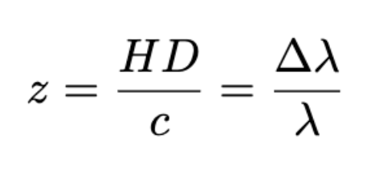
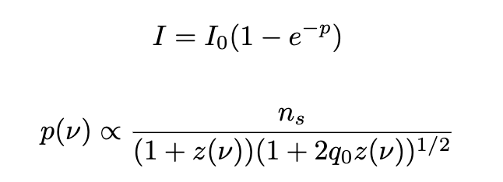
Gunn & Patterson Trough

Slide 4
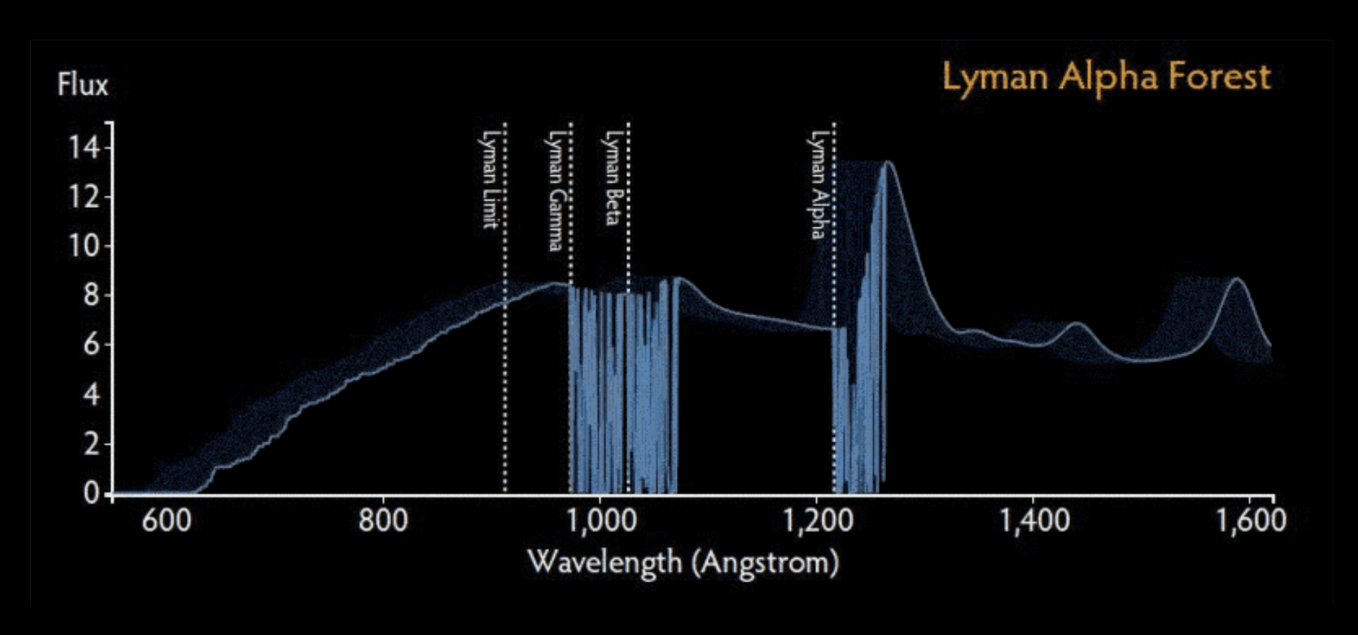
Lyman Alpha Forest (Bahcall & Salpeter )

Slide 5
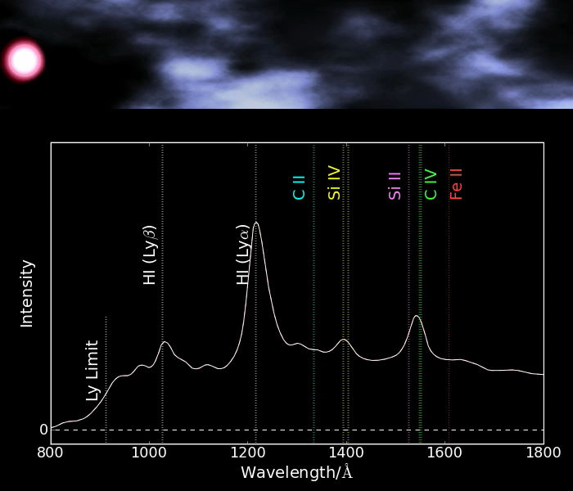
Lyman Alpha Forest

Slide 6
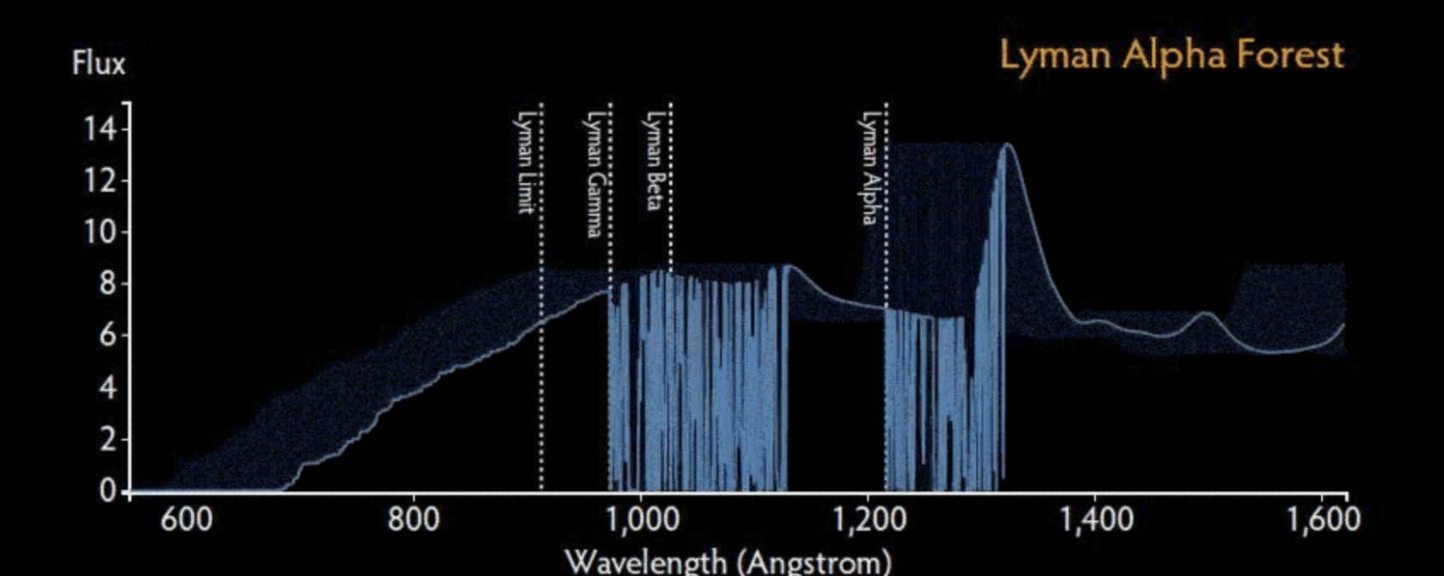
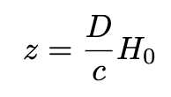
1.Redshift (distance & scale)

Slide 7
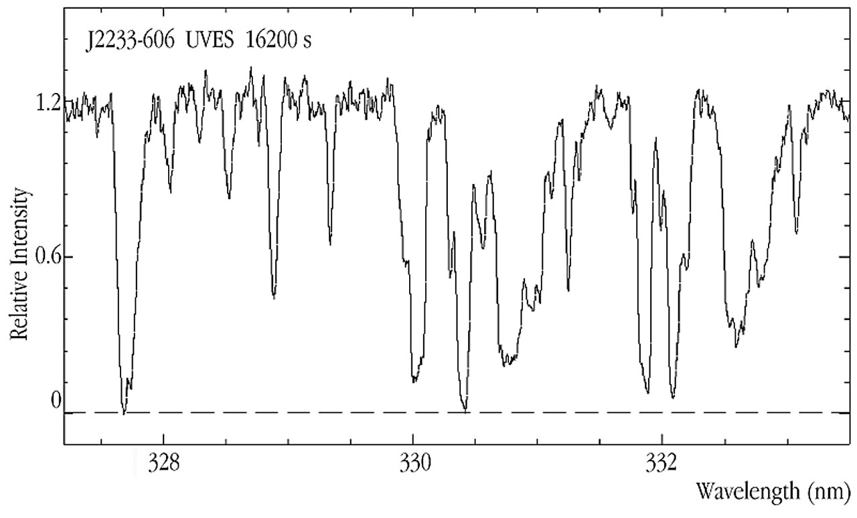
2. Depth (density & mass)

Slide 8
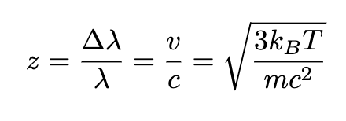
3. Width (temperature & Energy)

Slide 9
4. Neutral Fraction (Do quantum)

Slide 10
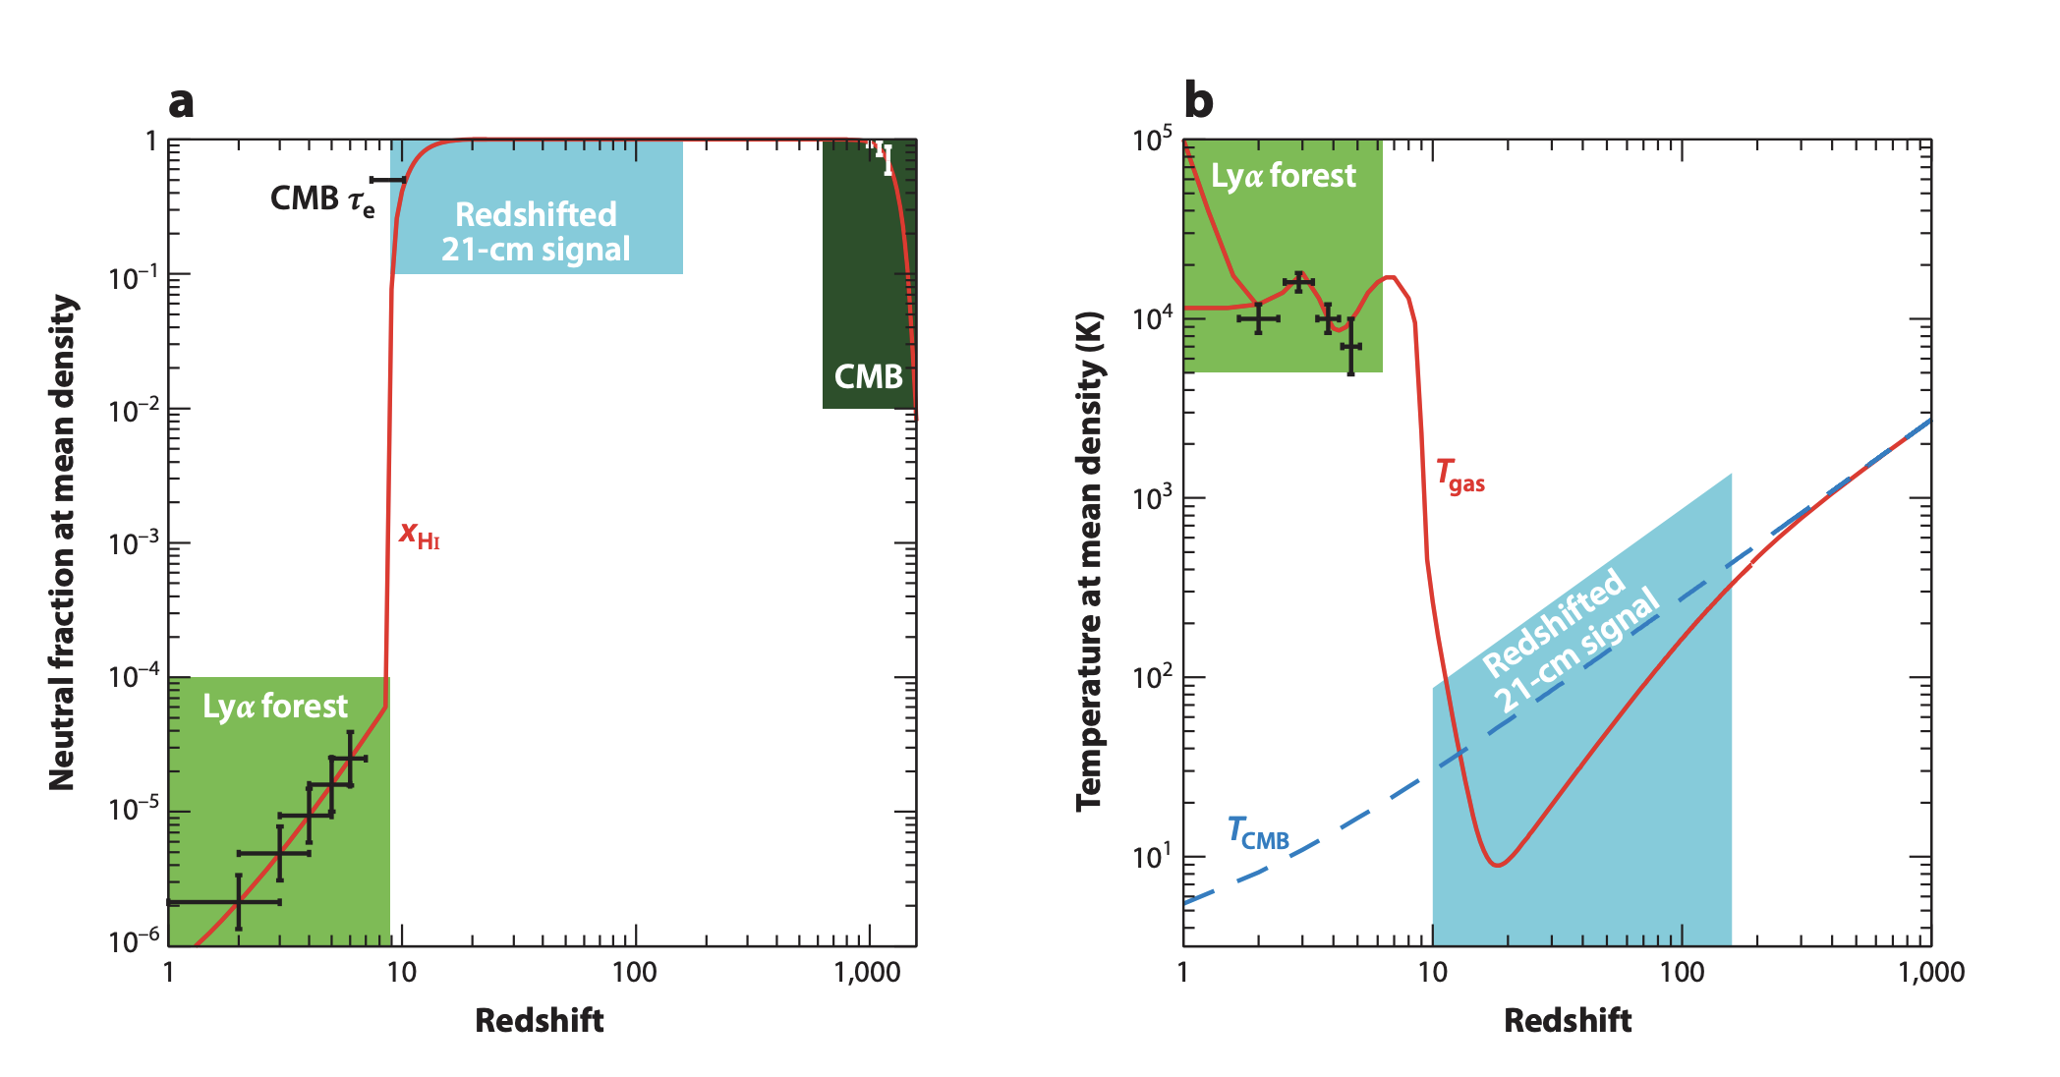
Intergalactic Medium Fun plots

Slide 11
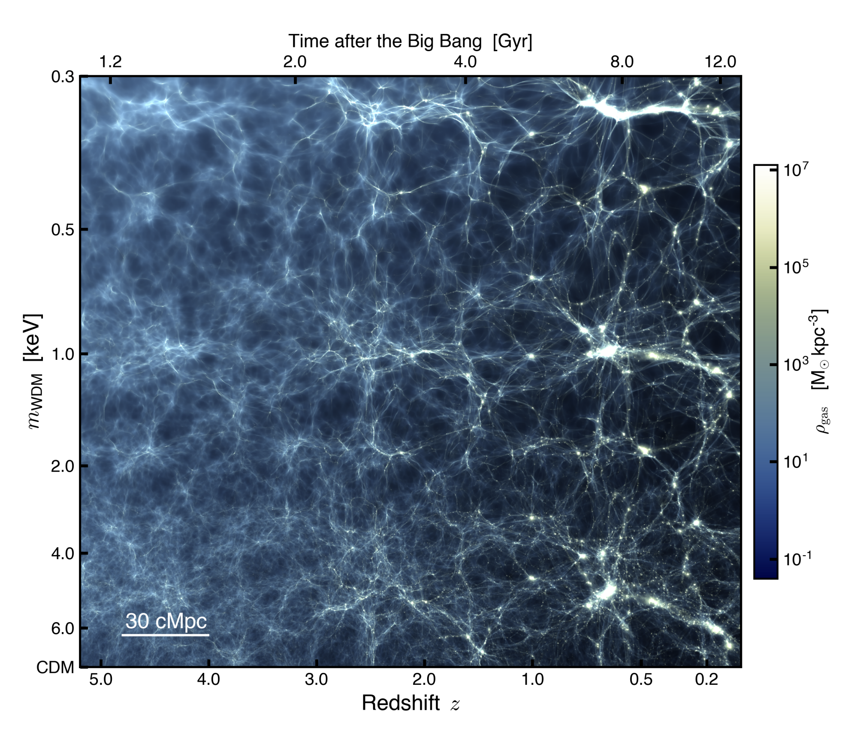
The big structure (CDM) (Cool done?)

Slide 12
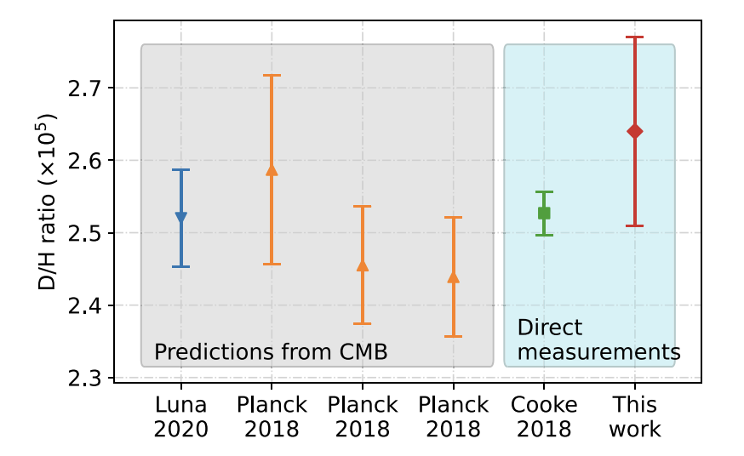
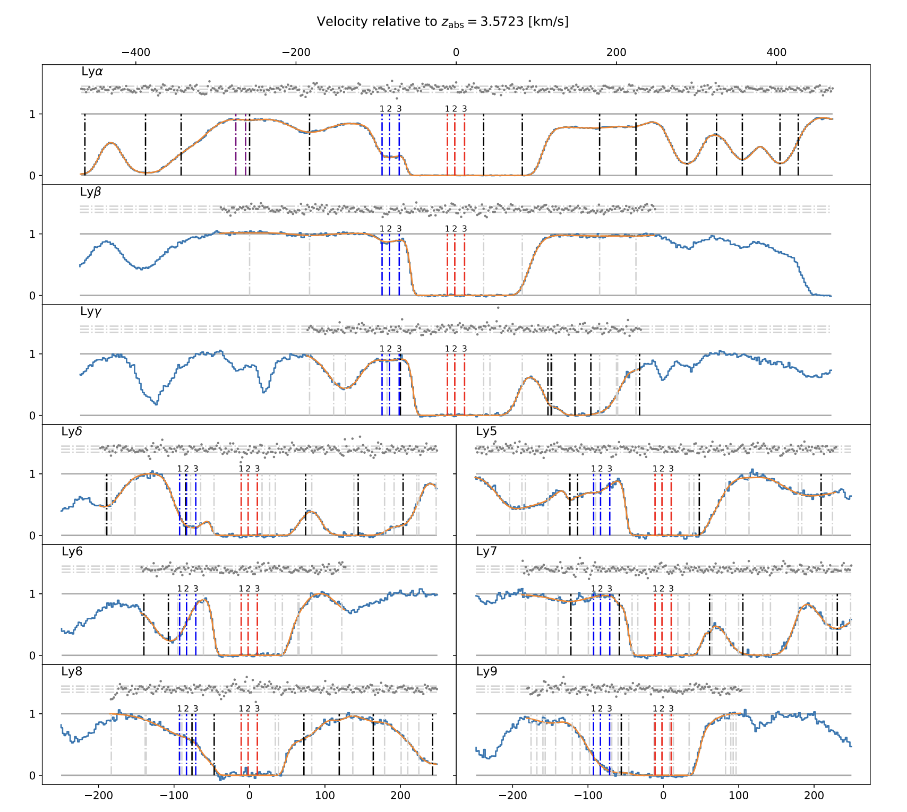
Nucelosynthesis (D/H)

Slide 13
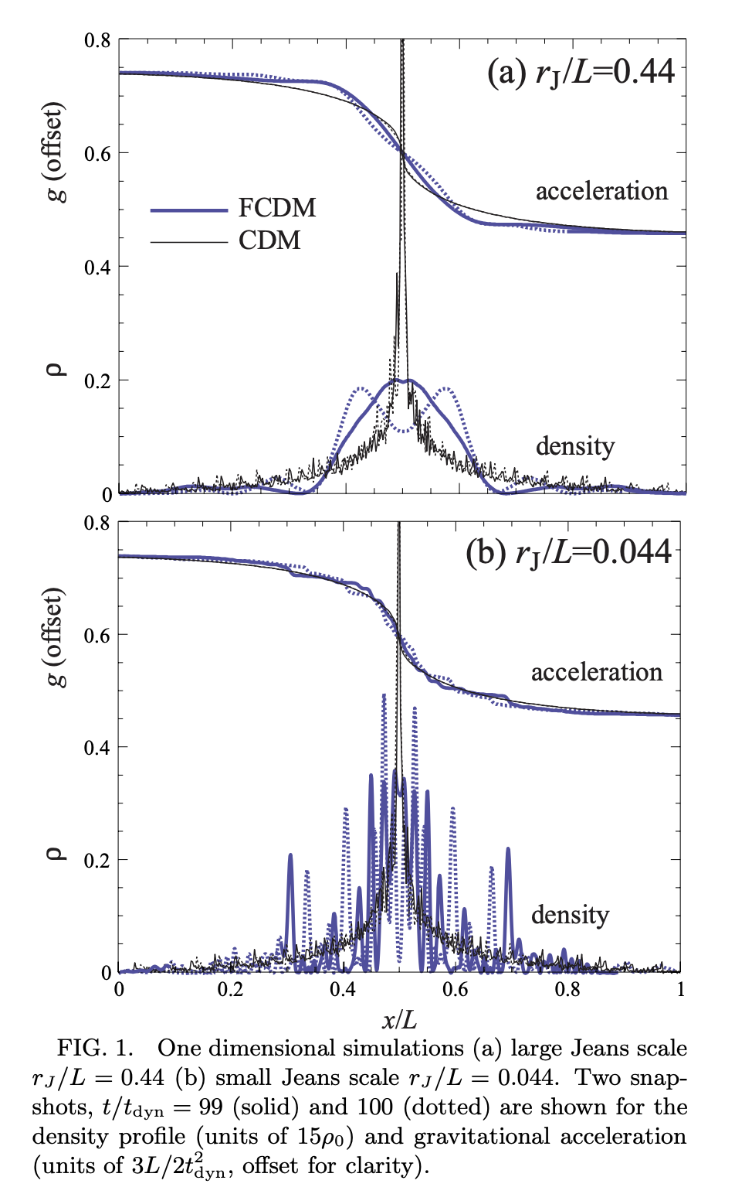
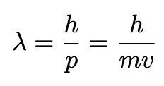
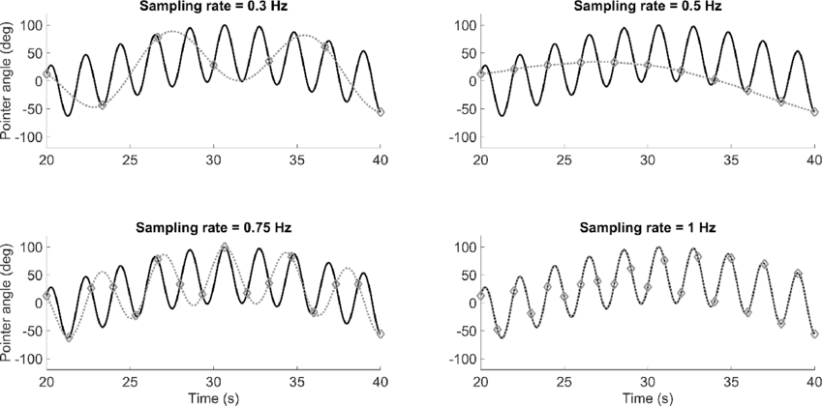
Ultra Light Dark Matter! (21cm forest)
No peak smaller than the wavelength!

